Slide 1
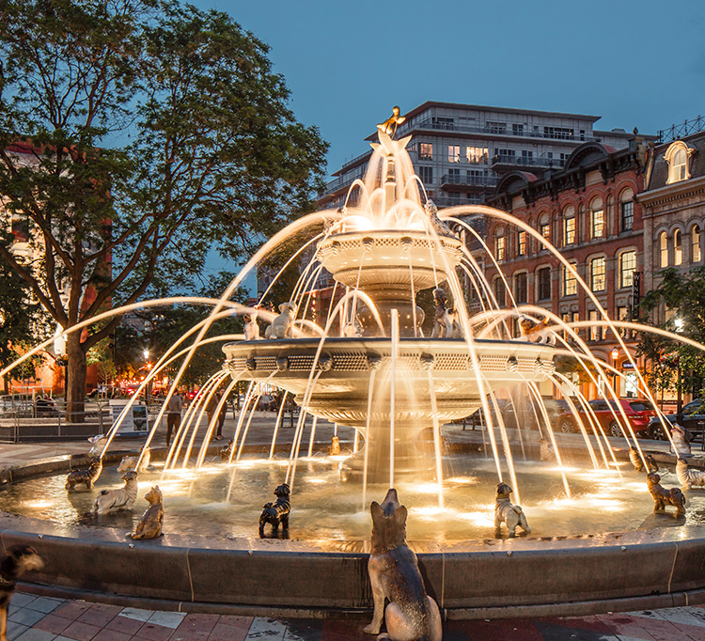
Finding the best location for a veterinary service in Toronto
February 5, 2021
Nebojsa Gogic

Slide 2
Project analysis slide 2
The Problem and How to Solve it
The problem:
Choosing an area that isn’t saturated with clinics and with lots of pets.
The Solution: Use data science to:
Find locations with no veterinary clinics or low number of veterinary services compared to number of pets.
Calculate the average YoY % increase rate as an additional parameter for detecting a good location.
Use exploratory tools (Folium maps, matplotlib and Pandas libraries) to visualize the data and analyze the results.

Slide 3
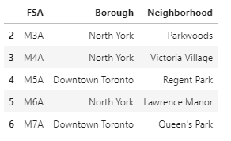
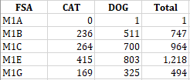
Project analysis slide 2
The Data Source
To solve the business problem, the following data is used:
The licensed dogs and cats report by forward station area (FSA) from the Toronto Open Data Portal. https://open.toronto.ca/dataset/licensed-dogs-and-cats-reports
List of Toronto neighborhoods from Wikipedia https://en.wikipedia.org/wiki/List_of_postal_codes_of_Canada:_M
FourSquare API to get the number and location of existing veterinary clinics in each neighborhood. https://developer.foursquare.com
Sample data:

Slide 4
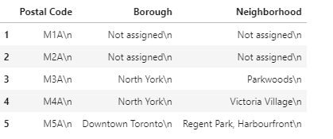
Project analysis slide 2
Data Cleaning
Removed the outliers from cats and dogs data:
Removed not assigned neighborhoods to FSA code:

Slide 5
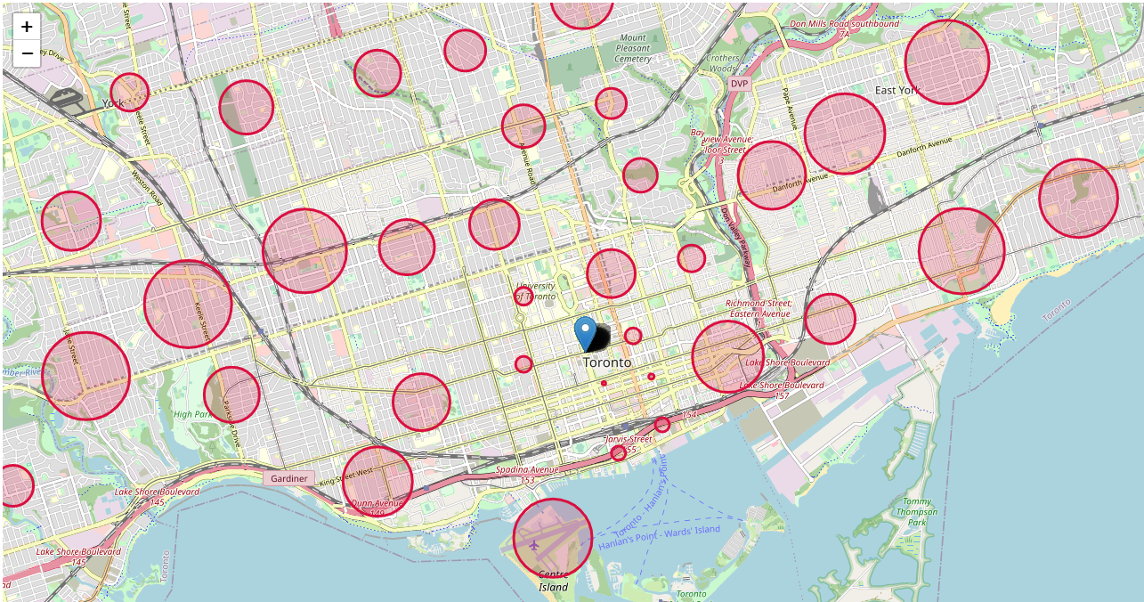
Project analysis slide 2
Data Visualization
Displaying the cleaned data on a map using Folium maps library
Size of each circle indicates the number of registered cats and dogs in the neighborhood.

Slide 6
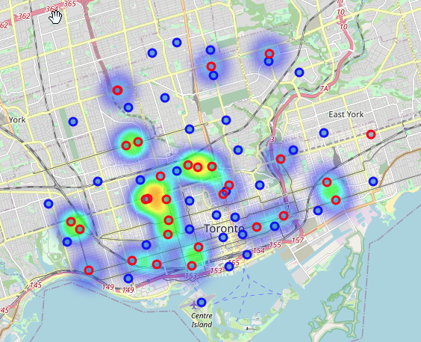
Project analysis slide 2
FourSquare API
Used FourSquare API to get veterinary clinics in each Toronto neighborhood.
Displayed neighborhood centers and veterinary venues on a map.
Used Folium’s heat map feature to visualize density of the veterinary venues.

Slide 7
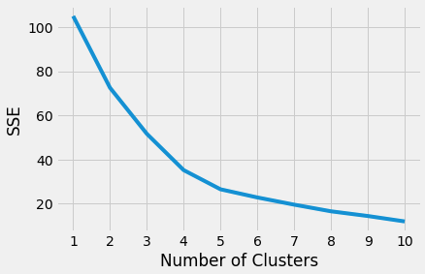
Project analysis slide 2
Data Clustering
Clustering model: K-Means, since the data is unlabeled.
Features: Number of Pets and number of veterinary venues.
Number of clusters: 4 – determined using the “Elbow” method.

Slide 8
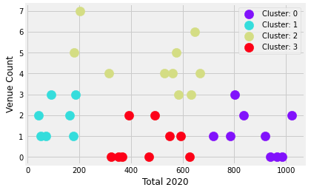
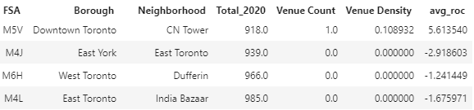
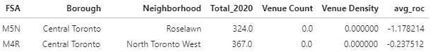
Project analysis slide 2
Cluster Analysis
Cluster 0: The largest number of pets and low number of venues.
Cluster 1: Low density of venues and small number of pets.
Cluster 2: High density of venues and moderate number of licensed pets.
Cluster 3: Low density of venues and moderate number of licensed pets.
Location candidates:
Cluster 0:
Cluster 3:

Slide 9
Project analysis slide 2
Results
CN Tower neighborhood
Close to the major highways Gardiner and Don Valley Parkway. 918 registered pets in 2020, only one existing veterinary venue
YoY rate of change: 5.61%. Definitely a good location for a veterinary service.
India Bazaar
The average YoY rate of pets registration: -1.68%.
No other venues nearby and the number of registered pets: 985. Close to the major highways. A good veterinary venue location.
Dufferin
The number of registered cats and dogs: 966. The average YoY rate of change in pets registration: -1.24%
No venues nearby. This is clearly a good location to open a veterinary venue.
East Toronto
Registered cats and dogs: 939. YoY rate of change in pets registration: -2.92
No venues nearby. This is a good location for a veterinary venue.
North Toronto West and Roselawn
Low density of veterinary venues. The number of registered pets: 367 and 324, respectively. YoY rate is close to 0.
Disadvantage: Far from downtown Toronto compared to other locations

Slide 10
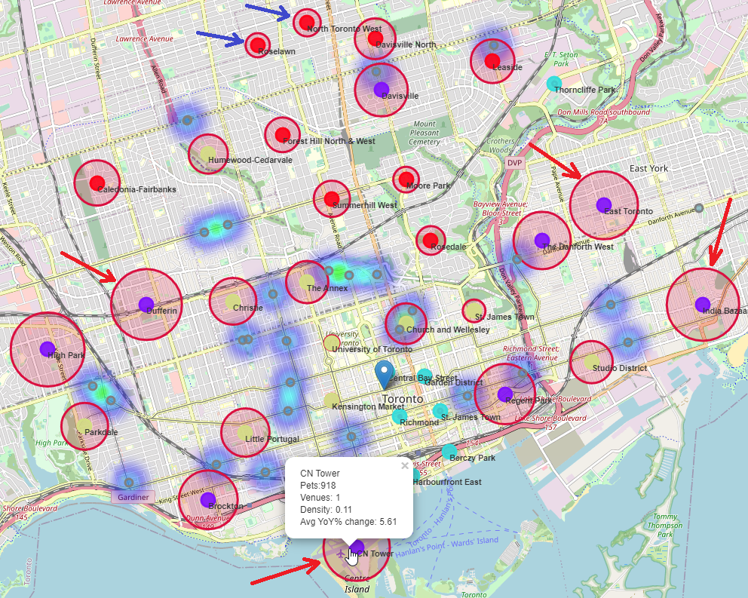
Project analysis slide 2
Conclusion
Using the licensed dogs and cats report by forward station area (FSA) from the Toronto Open Data Portal, list of Toronto neighborhoods with FSA from Wikipedia, FourSquare API, K-Means clustering algorithm and data exploration and analysis, the following neighborhoods were identified as locations that the stakeholders should be using as a starting point for the final exploration and decision:
CN Tower, India Bazaar, Dufferin and East Toronto.
The stakeholders should also explore the North Toronto West and Roselawn neighborhoods in the central Toronto area. These locations are relatively far from downtown Toronto compared to other good locations that we found but there are no veterinary venues nearby and the commercial rent could be significantly lower in this area.

Slide 11
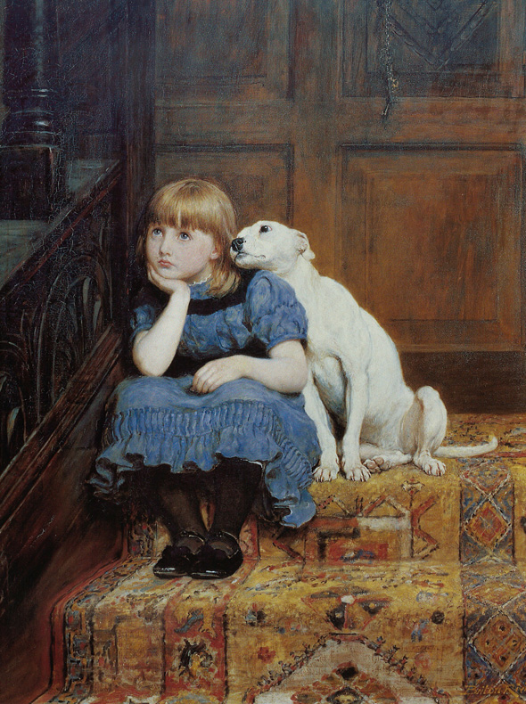
Project analysis slide 2
Future Works
Improve the accuracy of the model by including the commercial rent and demographics data that can be obtained from Statistics Canada. Commercial rents indexes for retail, office and industrial buildings is important information as well as the population density, structure, and growth.

